Slide 1

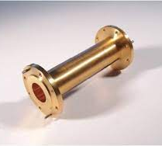
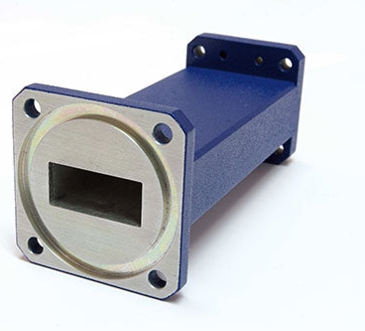
WHAT IS A WAVEGUIDE
BY KHETHIWE

Slide 2
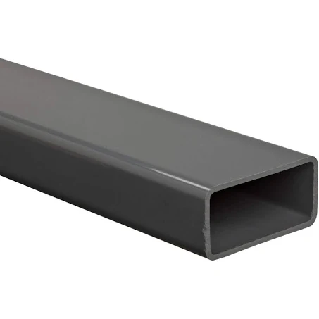
WAVEGUIDEs
It’s a guiding structure which your wave will travel from one point to another
Is a structure of the form of transmission line containg of a hallow metal tube
Waveguides are used in high frequency, for example radio frequency waveguide

Slide 3
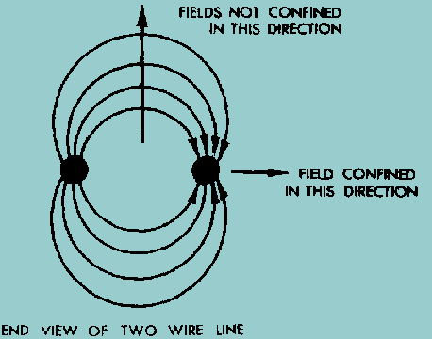


THEORY
Since we said waveguide is the structure of transmission line, so in circuit theory these lines have a length and characteristics impendance ($z=\frac{V}{I}$)
Consider two parallel wire (transmission line), when frequency increases the distance between parallel wires will be affected because the ratio of wavelength ($\frac{1}{λ}$) will have a very small amount, which will allow the parallel lines to receive electromagnetic wave
Waveguides are the most efficient way to transfer electromagnetic energy,
energy escapes by radiation because the fields are not confined in all directions

Slide 4
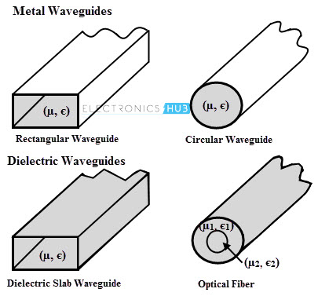
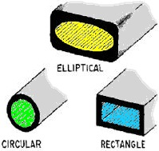
Types of Waveguides
Waveguides can be classified as either metal waveguides or dielectric waveguides. So, the metal waveguides are of the form of an enclosed conducting metal pipe which means waves are propagating inside a metal and are characterized by reflections from the conducting walls.

Slide 5
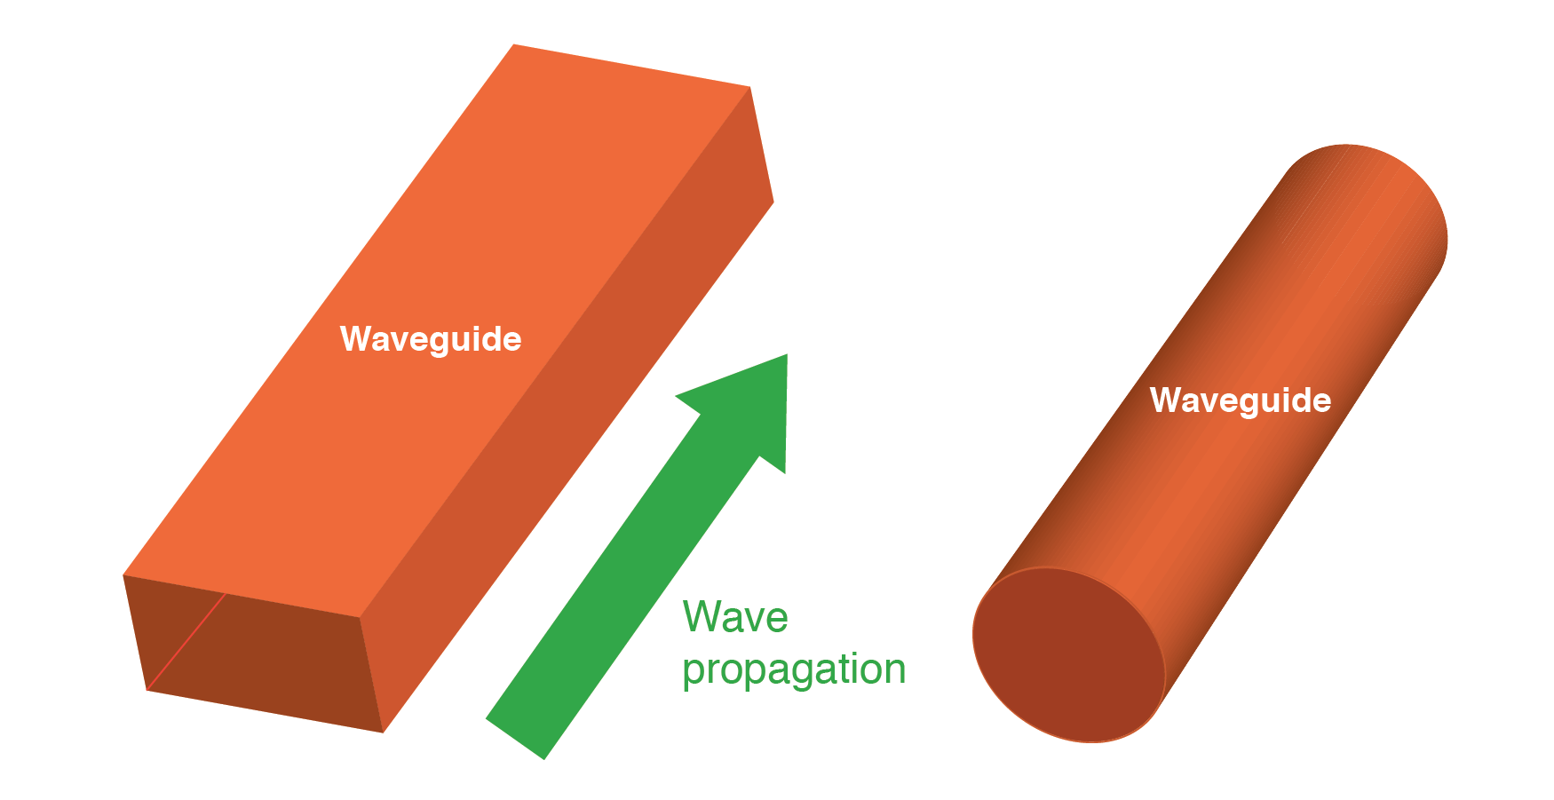
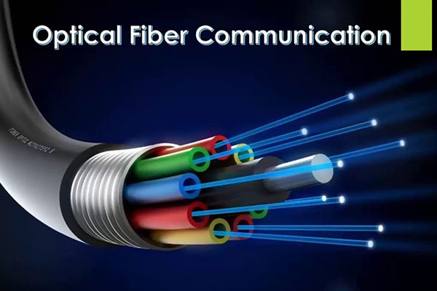

APPLICATIONS OF WAVEGUIDES
The tube walls provides distributed inductance
The empty space between the tube walls provides distributed capacitance
Waveguides are used in microwave communications
They are used in radar installation, optical fiber communication, photonic integrated circuits, mode cleaners, optical interferometers etc.

Slide 6
Advantages and disadvantages of waveguides
ADVANTAGES
DISADVANTAGES
They handle very large power
Power loss is negligible in waveguides
Are easy to manufacture, they offer very low loss
Not suitable for operations at lower frequency
It is very bulky in size, heavy in weight and expensive

Slide 7
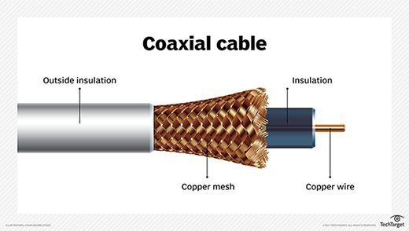
COMPARING WAVEGUIDES AND TRANSMISSION LINES
waveguides
TRANSMISSION LINES
Lower signals attenuation at high frequencies
Metal waveguides are enclosed conductor filled with an air
Large cross-section (low frequency) waveguides are impractical due to large size and high cost
Significant signal at high frequencies due to conductor and dielectric losses
Conductors are separated with some insulating medium (coaxial, two-wire etc.)
Large cross-section transmission lines can transmit high power levels

Slide 8
WHY YOU NEED A WAVEGUIDE?
In case of high frequency:
As the frequency goes higher and higher, what will happen is the loss will increase right or the attenuation will increase right. If that quantity is increasing, this is not good for any circuit. That is where waveguides operates, they are suggested to decrease the loss. So, by using the waveguides the loss will be less.

Slide 9
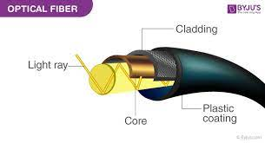
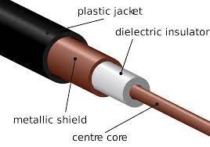
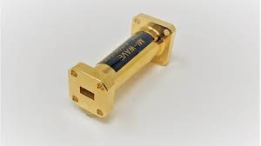
THANK YOU

